Slide 1
Group Project I
The Charlotteans

Slide 2
The recent growth rate of Charlotte has increased the standard of living despite the concerns for affordable housing.

Slide 3
Migration : population growth

Slide 4
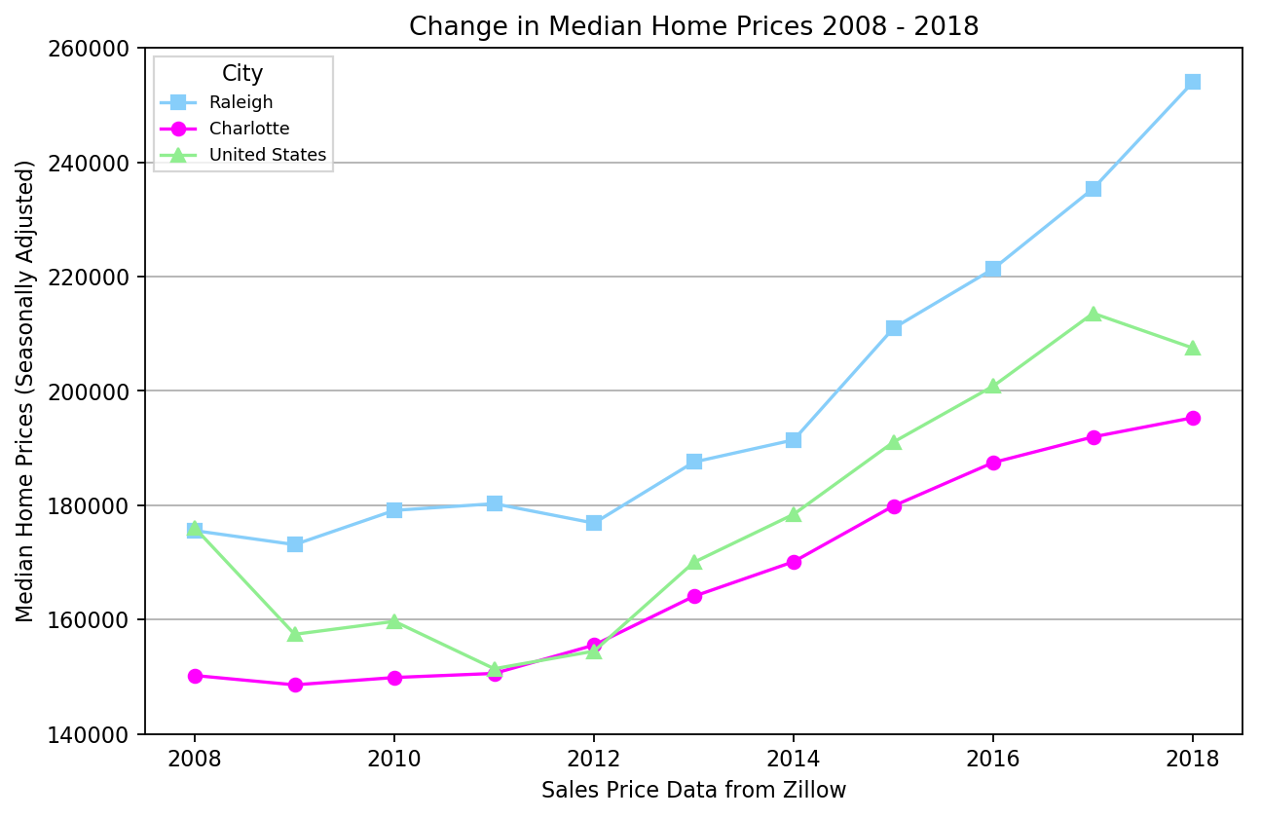
Livelihood : Housing prices

Slide 5
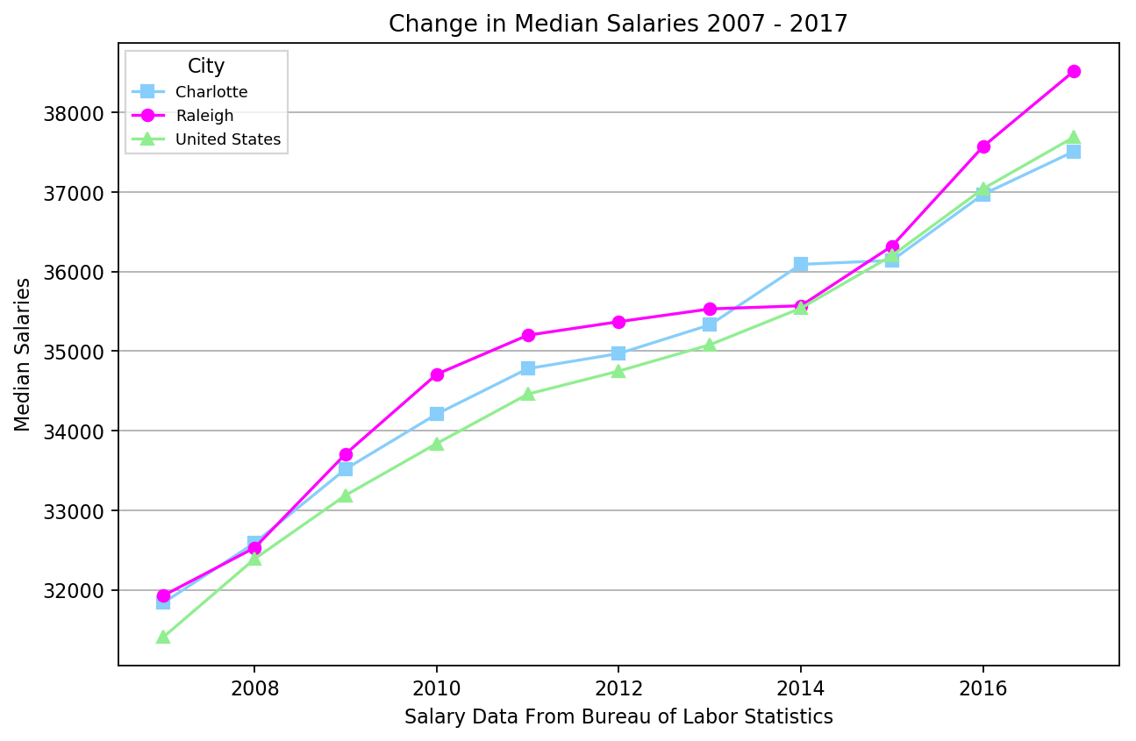
Economy : salary

Slide 6
Economy : unemployment rate

Slide 7
Economy : Poverty

Slide 8
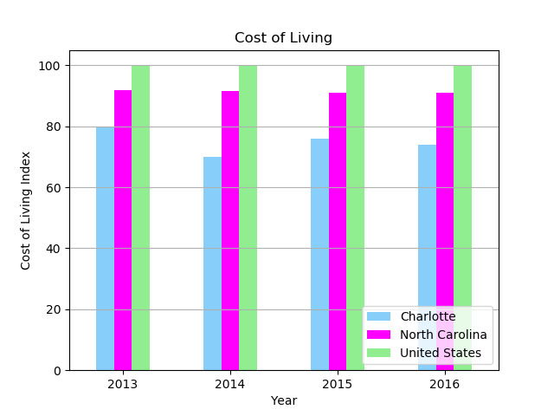
Economy : cost of living

Slide 9
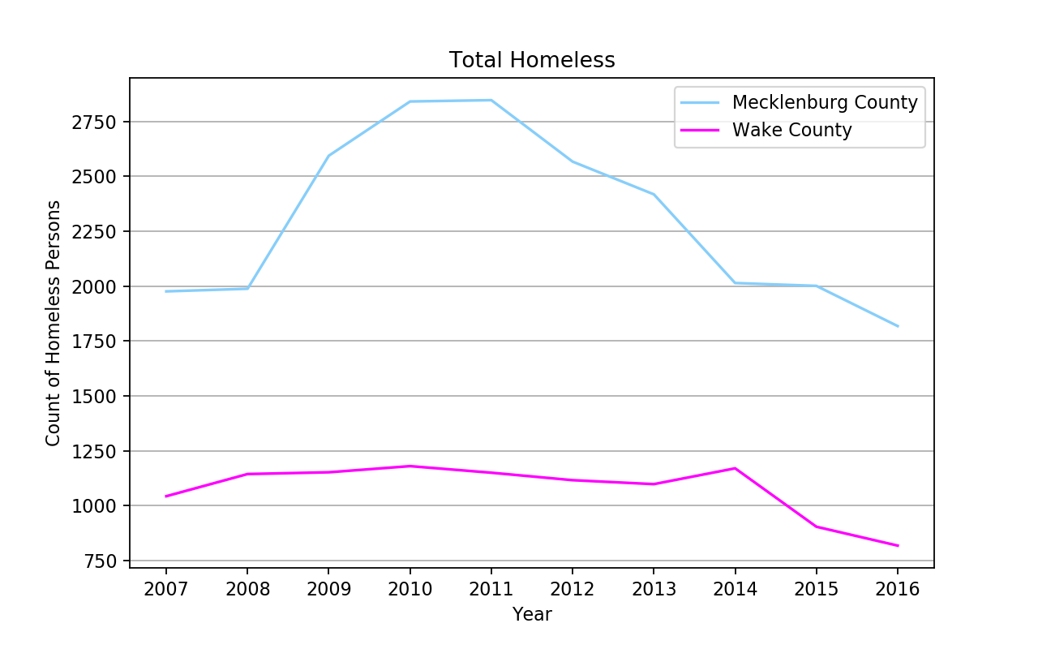
Community : Homelessness

Slide 10
Appendix : data sources

